Slide 1

Hello, my name is _______.

Slide 2



Here’s what you should know about me:
I like
soccer
basketball
and
football

Slide 3
and I also…
STUTTER

Slide 4
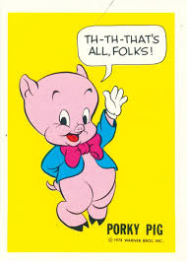
What is stuttering?
It’s when it’s hard to get the words out when you are talking.
Everyone stutters sometimes!

Slide 5
There are many ways a person can stutter. There is…

Slide 6
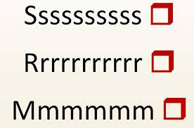
PROLONGATION
That’s when a sound goes on too long at the beginning of a word.

Slide 7
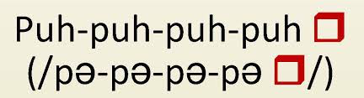
DUPLICATION
That’s when you say the same syllable or word more than once

Slide 8

BLOCK
That’s when you try to speak but your throat is tense and nothing comes out!

Slide 9
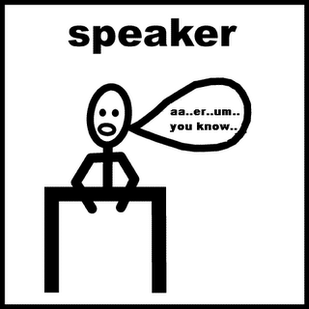
Filler Words
That’s when you put in words that don’t mean anything to stall for time

Slide 10
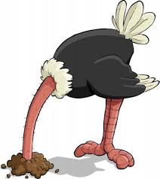
Avoidance
Changing your words and sounds, or not talking at all, is called AVOIDANCE

Slide 11
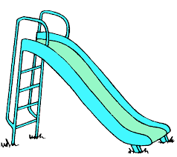

Once I wanted to go on the slide, but I knew I was going to have a hard time saying “slide”. So I asked my friend, “Do you want to go on the sl--…swing?”
I didn’t even WANT to go on the swing, but it was easier than saying “slide”!
That’s called AVOIDANCE!

Slide 12

If you use avoidance techniques, you may not stutter, but it’s very STRESSFUL!

Slide 13

Who Stutters?
About 5% of all children stutter for at least a six months period.
Three-quarters of children who stutter recover by late childhood.
About 1% of the population has a long-term stuttering problem.
There are three to four times as many boys who stutter as there are girls.
Almost half of all children who stutter have a family member who stutters.

Slide 14
Here are some famous people who stutter…

Slide 15
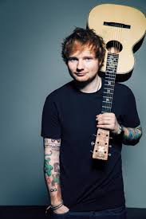
Ed Sheeran Musican

Slide 16
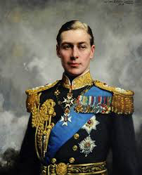
George VI
King of England

Slide 17
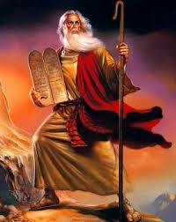
Moses
leader of the Israelites

Slide 18
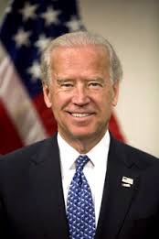
Joe Biden
Vice President of the U.S.

Slide 19
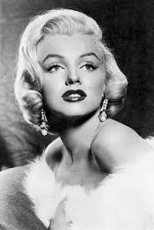
Marilyn Monroe
actress

Slide 20

Samuel L. Jackson
Nick Fury from The Avengers

Slide 21
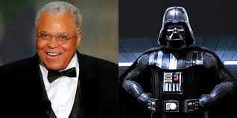
James Earl Jones
voice of Darth Vader
from Star Wars

Slide 22

My Story
I started stuttering in kindergarten.
I have been going to speech therapy for four years.
My dad, auntie, uncle, grandma and grandpa also stutter.

Slide 23
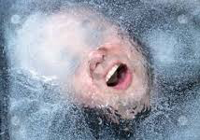
What does stuttering feel like?
It feels like taking without enough air
It feels like your throat is really tight
It makes it hard to talk

Slide 24
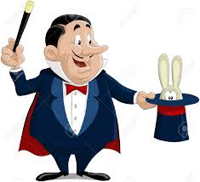
Here are tricks that help me with my stuttering
I take a breath before speaking
I start over my sentence when I’m making a lot of stuttering mistakes.

Slide 25
Here is how you can help:
Please take your time with me.
Do not make fun of me.
Know that just because I stutter doesn’t mean I’m not smart.

Slide 26

Stuttering may be hard…
but isn’t going to stop me from being the best student and the best person I can be!

Slide 27

Do you have any questions?

