Slide 1
Instructions
CONGRATULATIONS!
It’s Time To Talk About Your Stutter!
Fill in the blanks throughout this PowerPoint to make it all about you!
Add pictures, info, anything you can think of to share with your class!
Delete information that does not apply to you.
You are in charge!
Remember you are AWESOME and HAVE FUN!

Slide 2

I AM
(insert name here)
& SOMETIMES I STUTTER!
Notes:
This photo by unknow author is licensed under CC BY-ND

Slide 3
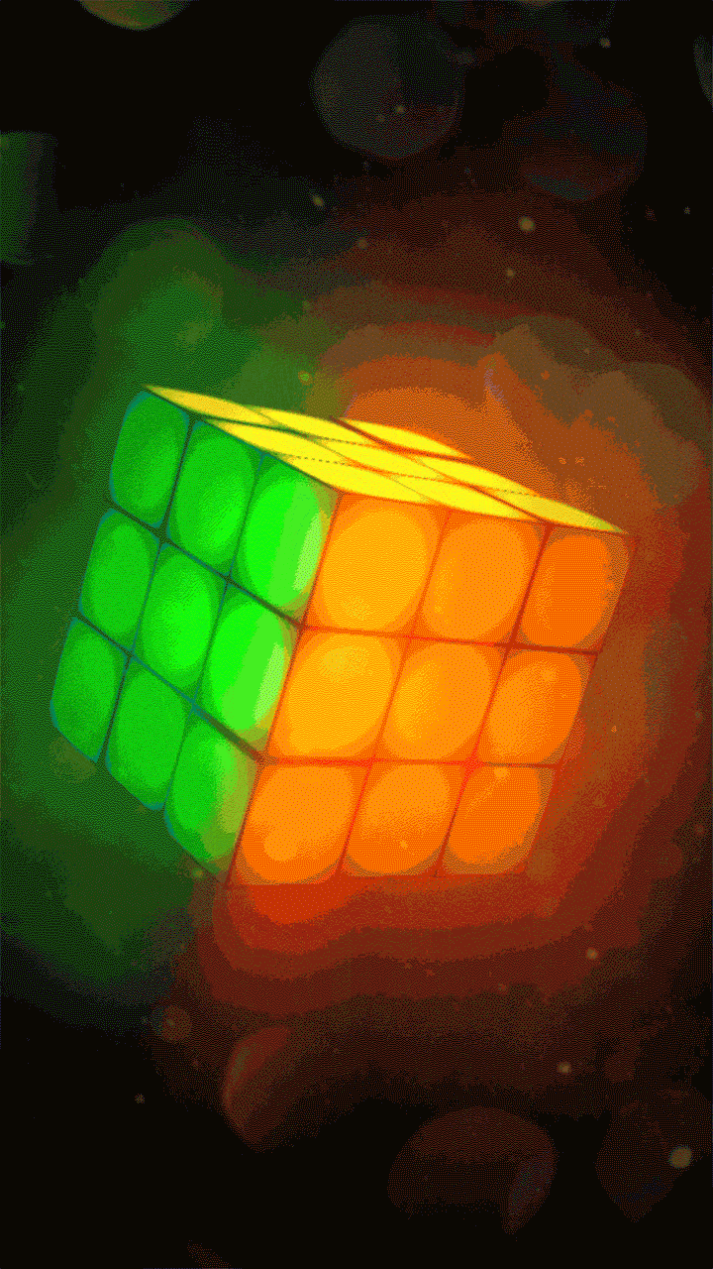
All About Me
I am interesting because….
Notes:
http://livewallpapersfreedownload.blogspot.com/2017/04/animated-mobile-phone-wallpapers-gif.html

Slide 4
My Life
-----[insert photo here]------
I am ______ years old
I attend ______ school
I am in the ______ grade

Slide 5
My Favorites
My Best Friends Are:
-----[insert photo here]------
Hobby: ______
Music: ______
Sports Team: ______
Food: ______
Color: ______
My Pets:
-----[insert photo here]------

Slide 6
My Family
-----[insert photo here]------
Who I live with:
__________
___________

Slide 7
And I Stutter
-----insert happy, thumbs up picture of yourself------
Sometimes I repeat words
Sometimes my words get stuck
#stutteringisnobigdeal

Slide 8


What Should You Do?
I do not want you to correct me
I would like for you to not say anything
Just listen and let me finish talking
Notes:
https://wallpapercave.com/wallpaper-3d-animation-gif
https://www.pinterest.com/pin/544654148683515309/?lp=true

Slide 9


Guess Who
Stutters...
Notes:
https://www.pinterest.com/pin/565624034424674951/?lp=true
https://backgrounddownload.com/up-background-6/

Slide 10
Mystery Person #1
Actress
Woman
Babysitter
Magic Bag
Can fly with an umbrella
Practically Perfect in Every Way

Slide 11

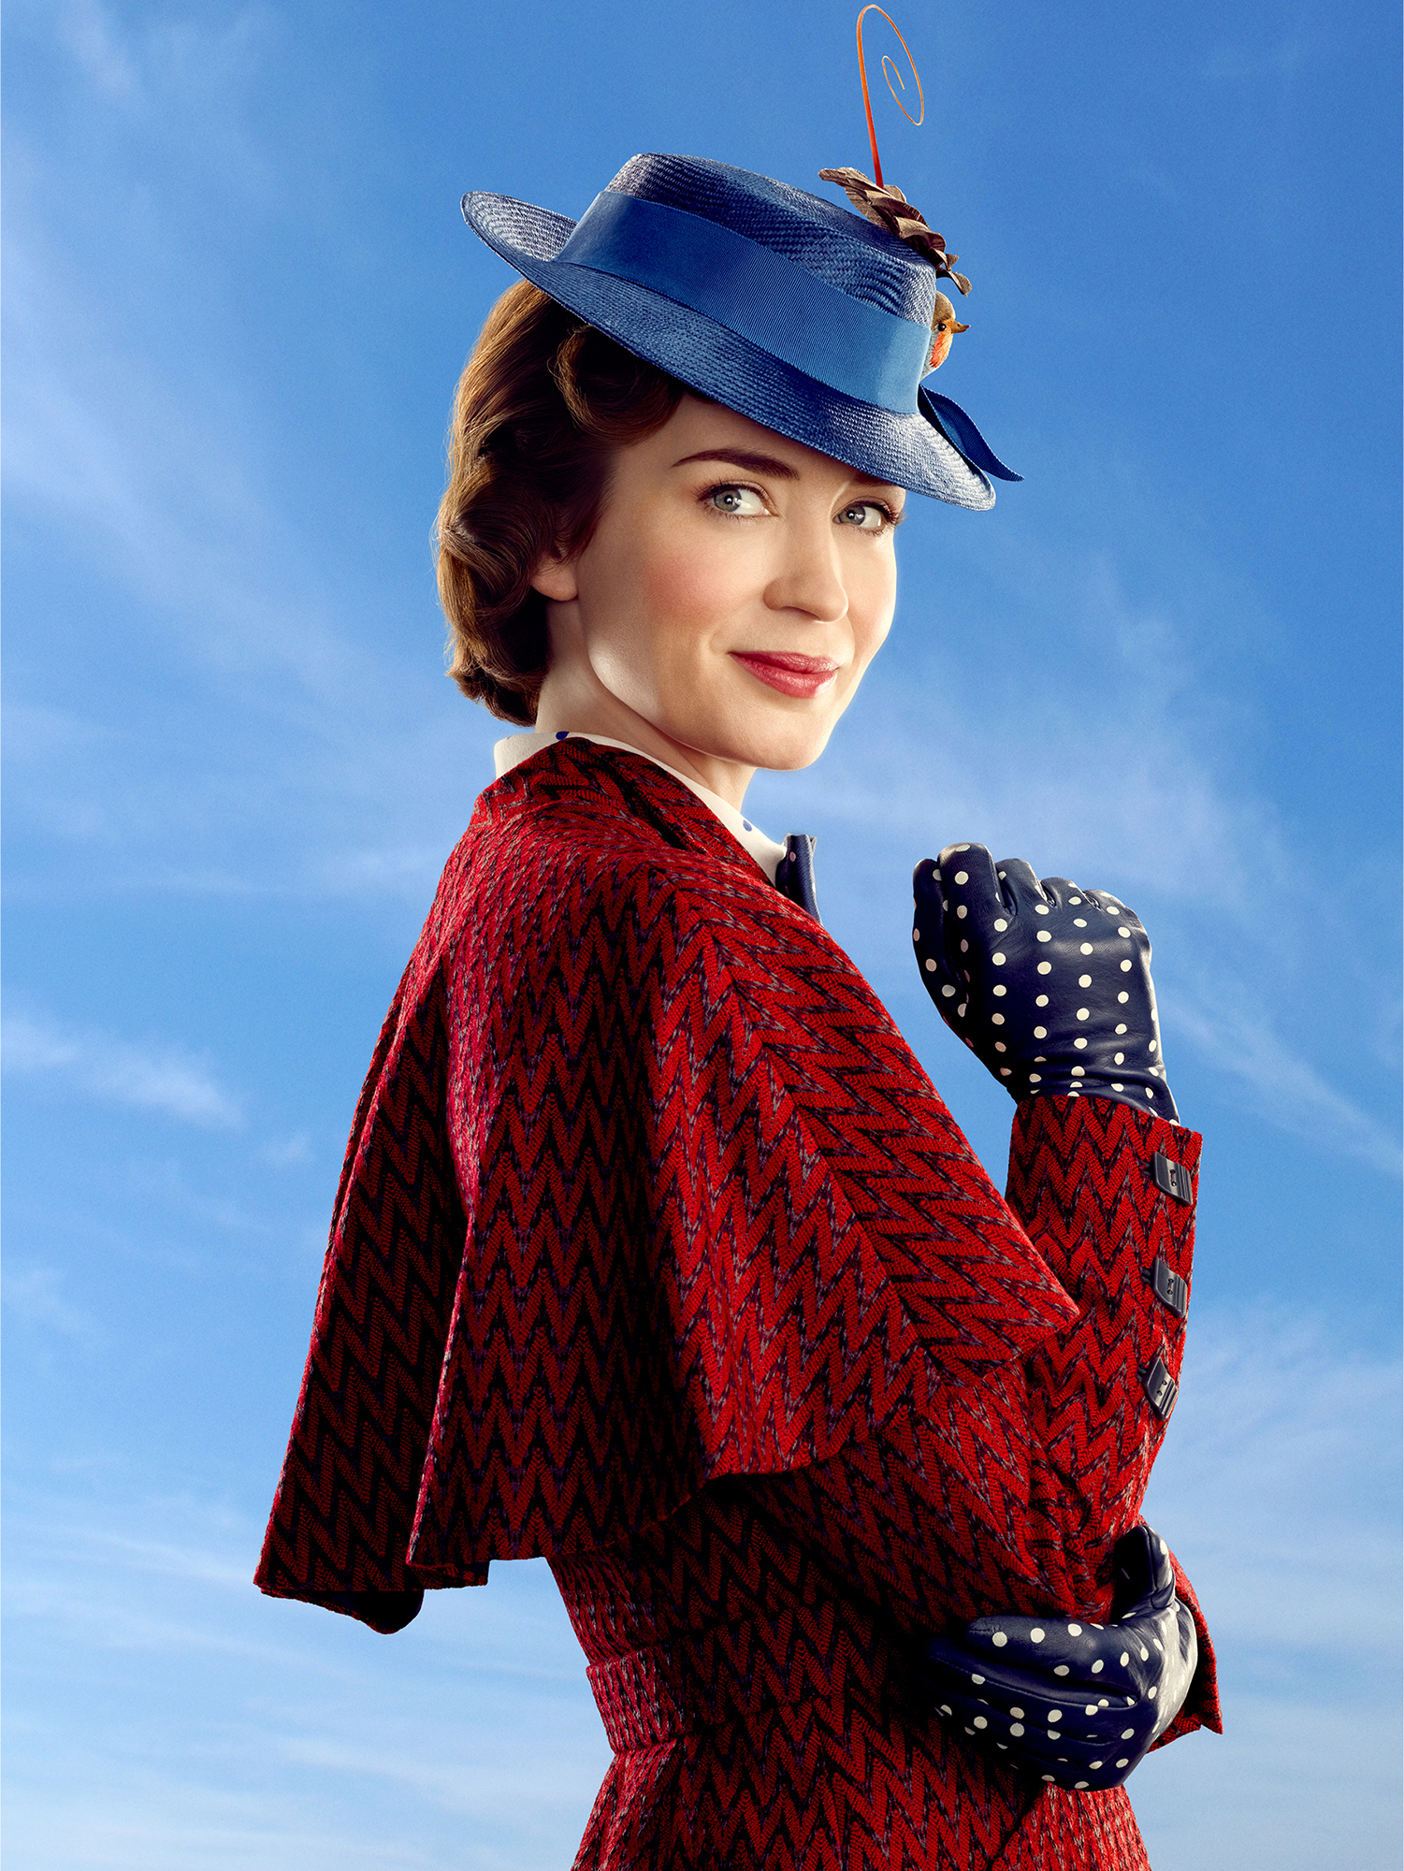
Emily Blunt!
Notes:
https://i.pinimg.com/originals/c7/db/b0/c7dbb04ef90334c889b5dc67d07b855a.jpg
https://www.refinery29.com/en-gb/2018/03/192676/mary-poppins-reboot-trailer-emily-blunt-lin-manuel-miranda

Slide 12
Mystery Person #2
Singer/Songwriter
Male
British
Red Hair
“Perfect”
“Thinking Out Loud”

Slide 13

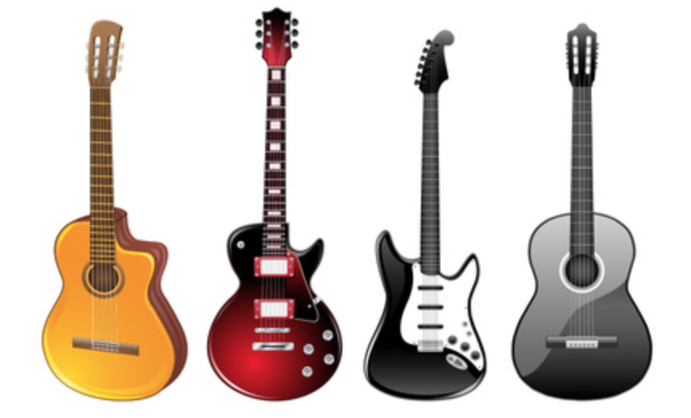
Ed Sheeran!
Notes:
http://clipart-library.com/clipart/rinGnzbbT.htm
http://www.bbc.co.uk/newsbeat/article/40443039/ed-sheeran-ups-fight-against-ticket-touts-with-strict-rules-for-2018-gigs

Slide 14

TRUE OR FALSE?
Notes:
https://wifflegif.com/gifs/564911-fabian-oefner-sound-waves-gif

Slide 15

Stuttering is contagious
Notes:
https://giphy.com/explore/bacteria

Slide 16

FALSE!

Slide 17

Over 3 million people in the U.S. stutter
Notes:
http://www.oogazone.com/2018/best-free-crowd-silhouette-vector-cdr/

Slide 18

TRUE!
TRUE!
Notes:
https://scherryvankirk.com/motion-graphics

Slide 19

PEOPLE STUTTER
ALL OVER
THE WORLD
IN DIFFERENT LANGUAGES
Notes:
https://angelicangeles.home.blog/2018/10/11/globalization-in-the-philippines/

Slide 20

TRUE!
Notes:
https://www.pinterest.com/pin/495184921504907774/?lp=true

Slide 21
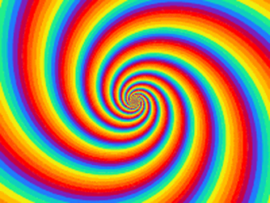
COOL PEOPLE WHO STUTTER. . .
Notes:
https://gfycat.com/fr/idlewelcomebetafish

Slide 22
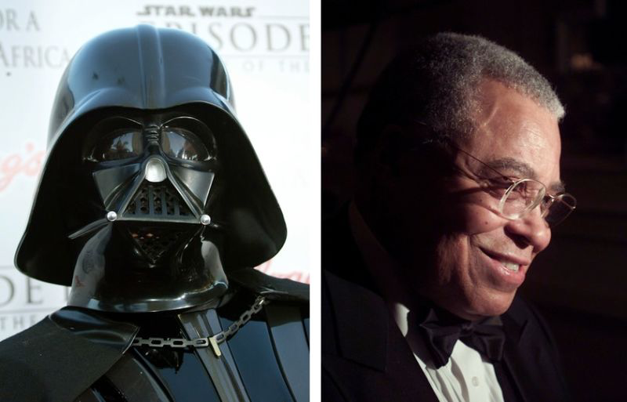
VOICE OF DARTH VADER!
Notes:
Insert Darth Vader Voice
https://kinja.com/api/profile/getsession?redirect=https%3A%2F%2Fgizmodo.com%2Fsetsession%3Fr%3Dhttps%253A%252F%252Fgizmodo.com%252Fjames-earl-jones-was-originally-paid-7-000-for-voicing-1659817892

Slide 23

ATHLETE GEORGE SPRINGER!
Notes:
https://www.crawfishboxes.com/2019/2/22/18236456/should-the-astros-extend-springer-what-would-it-cost

Slide 24

ATHLETE TIGER WOODS!
Notes:
https://fivethirtyeight.com/features/tiger-woods-completes-his-staggering-career-comeback/

Slide 25
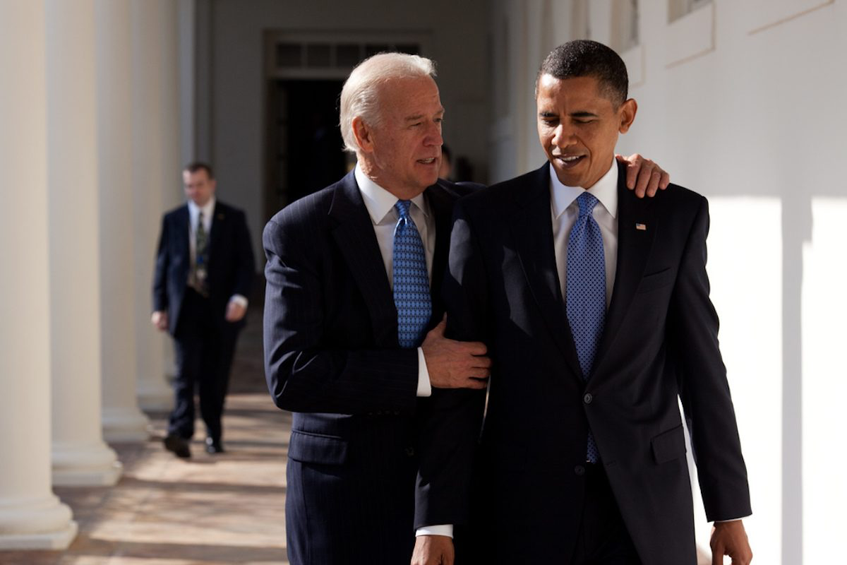
FORMER VICE PREZ. JOE BIDEN!
Notes:
https://www.themarysue.com/remember-remember-obama-biden/

Slide 26

STUTTERING
IS
EVERYWHERE!

Slide 27
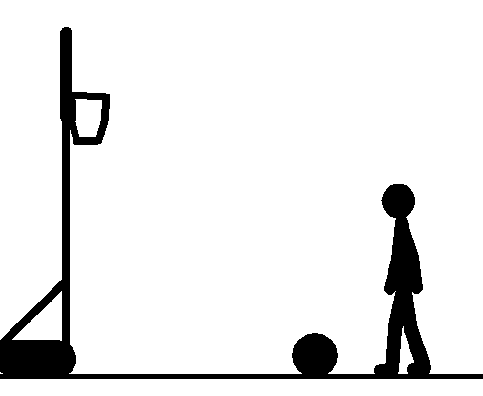
THE END.
Notes:
http://clipart-library.com/clipart/qiBo9KX5T.htm

Slide 28
References
Animated Basketball #1758418 (License: Personal Use). (n.d.). Retrieved May5, 2019, from http://clipart-library.com/clipart/qiBo9KX5T.htm
Angelic Angeles. (2018, October 12). Globalization in the Philippines. Retrieved May 5, 2019, from https://angelicangeles.home.blog/2018/10/11/globalization-in-the-philippines/
Anonymous. (2016, October 17). Spiral - Create, Discover and Share Awesome GIFs on Gfycat. Retrieved May 5, 2019, from https://gfycat.com/fr/idlewelcomebetafish
Behance. (n.d.). Planetary get-together. Retrieved May 5, 2019, from https://www.behance.net/gallery/45545671/Planetary-get-together
Best Free Crowd Silhouette Vector Cdr. (2018, September 17). Retrieved May 5, 2019, from http://www.oogazone.com/2018/best-free-crowd-silhouette-vector-cdr/
Cohn, B. (2019, February 22). Should the Astros extend Springer? What would it cost? Retrieved May 5, 2019, from https://www.crawfishboxes.com/2019/2/22/18236456/should-the-astros-extend-springer-what-would-it-cost
Cool Animated Wallpaper For Mobile GIF Images Moving D 480×480 Gif Wallpapers (10 Wallpapers) | Adorable Wallpapers | Desktop | Art optical, Illusion art, Art. (n.d.). Retrieved May 5, 2019, from https://www.pinterest.com/pin/689473024173278065/?lp=true
Ed Sheeran ups fight against ticket touts with strict rules for 2018 gigs - BBC Newsbeat. (2017, June 29). Retrieved May 5, 2019, from http://www.bbc.co.uk/newsbeat/article/40443039/ed-sheeran-ups-fight-against-ticket-touts-with-strict-rules-for-2018-gigs
Fabian oefner sound waves gif. (n.d.). Retrieved May 5, 2019, from https://wifflegif.com/gifs/564911-fabian-oefner-sound-waves-gif
Giphy. (n.d.). Bacteria GIFs - Get the best GIF on GIPHY. Retrieved May 5, 2019, from https://giphy.com/explore/bacteria
Gudangblog. (n.d.). Animated Mobile Phone Wallpapers GIF For Samsung Moving 3D Screensaver. Retrieved May 5, 2019, from http://livewallpapersfreedownload.blogspot.com/2017/04/animated-mobile-phone-wallpapers-gif.html
Guitar Vector Art #1231776 (License: Personal Use). (n.d.). Retrieved May 5, 2019, from http://clipart-library.com/clipart/rinGnzbbT.htm

Slide 29
References Continued
JPlanos. (2019, April 14). Tiger Woods Completes His Staggering Career Comeback. Retrieved May 5, 2019, from https://fivethirtyeight.com/features/tiger-woods-completes-his-staggering-career-comeback/
Motion Graphics. (n.d.). Retrieved May 5, 2019, from https://scherryvankirk.com/motion-graphics
Medeiros, M. (n.d.). The New 'Mary Poppins' Is A Spoonful Of Sweet Nostalgia. Retrieved May 5, 2019, from https://www.refinery29.com/en-gb/2018/03/192676/mary-poppins-reboot-trailer-emily-blunt-lin-manuel-miranda
Moving animation images | Moving animated Question Marks And Exclamation Point gif animations | Recipes to Cook | Shake the dust, Question mark, Kitchen measurements. (n.d.). Retrieved May 5, 2019, from https://www.pinterest.com/pin/565624034424674951/?lp=true
Rachelleishman. (2018, October 30). Here, Remember the Good Old Days of Obama and Biden Memes. Retrieved May 5, 2019, from https://www.themarysue.com/remember-remember-obama-biden/
Up background 6. (n.d.). Retrieved May 5, 2019, from https://backgrounddownload.com/up-background-6/
Wallpapers 3D Animation Gif. (n.d.). Retrieved May 5, 2019, from https://wallpapercave.com/wallpaper-3d-animation-gif
We are MSLGROUP. (2019, May 30). Retrieved May 5, 2019, from https://www.pinterest.com/pin/495184921504907774/?lp=true
You, Finger Pointing, Finger | hair color | How to start conversations, Emoji love, Emoji faces. (n.d.). Retrieved May 5, 2019, from https://www.pinterest.com/pin/544654148683515309/?lp=true
Zielinski, L. (2017, December 07). Who was the voice of Darth Vader? Retrieved May 5, 2019, from https://www.metro.us/entertainment/movies/who-was-the-voice-of-darth-vader

